Slide 1
Show of Hands Final Presentation
Asad Mehdi, Nathan Strelser, David Ivey, Joseph Noel, Max Wang

Slide 2
Our Team
Asad Mehdi: Back-End Developer
David Ivey: Back-End Developer
Nathan Strelser: Front-End Developer
Max Wang: Front-End Developer
Joseph Noel: Full-Stack Developer

Slide 3
Agenda
Introduction/Overview
Propublica Congress API
Functional Requirements
Non-functional Requirements
Technologies
Architecture
Project Methodology
Demo
What we learned/Future plans
Conclusion/Questions

Slide 4
Overview
Web application that provides information and analytics based on congressional data
Data visualizations that focus on voting behavior
Easy to digest user interface

Slide 5

Propublica Congress API
https://propublica.github.io
Retrieved legislative data from House of Representatives, Senate, and Library of Congress
API responded with JSON
propublica-congress-node module streamlined process with Node.JS

Slide 6
Functional Requirements
Basic information about congress members
Summary of recent bills
Visualizations of bill voting data in concise and easy to understand way
Visualizations of voting behavior

Slide 7
Non-functional requirements
Data visualizations should not be overwhelming or confusing
Should be easy to locate what user is interested in
Support for all members of Congress
Support for all recent bills
Data pulled from API and updated regularly

Slide 8
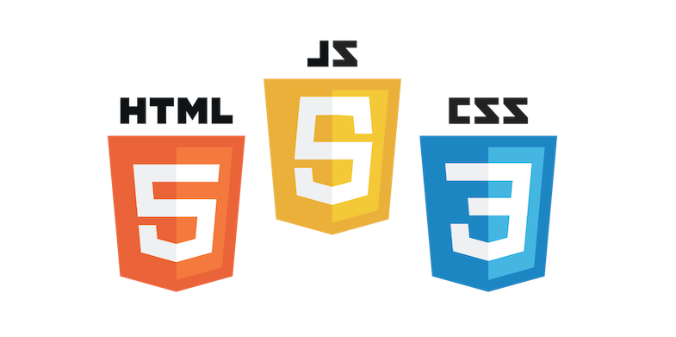



Front-End Technologies
HTML5/CSS3/Javascript
jQuery (Map)
AngularJS
Bootstrap
D3

Slide 9
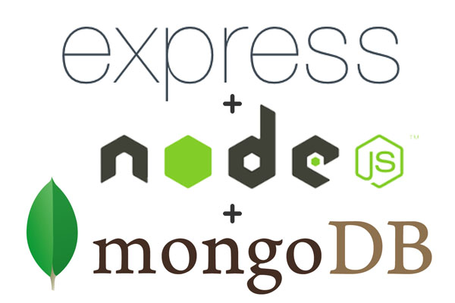
Back-End Technologies
NodeJS
Express
MongoDB/Mongoose

Slide 10
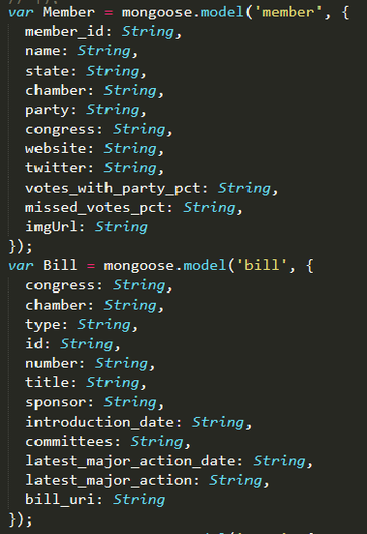
Architecture
Using Mongoose schemas we upload member and bill data to the Mongo database.
When pages load they send a get or post request to Node.js which returns data from the Mongo database
Display the data in a readable format using AngularJS and Bootstrap.

Slide 11
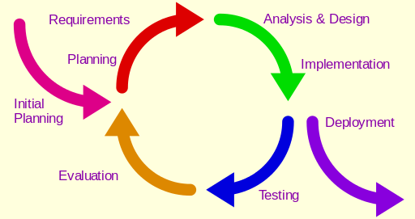
Project Methodology
Iterative
Notes:
We began with an agile methodology, but realized fairly quickly that while we knew what we wanted to get out of the application in a broad sense, we weren’t solid on exactly what we wanted it to show. We also wanted to be able to evaluate the application to determine how the different aspects were going to work and make changes accordingly throughout the development process. This lead us to the iterative development methodology. This allowed us to create a prototype to work with, figure out what we wanted to see in the next iteration, and then modify our plan to fit the upcoming features as well as to accommodate the team’s schedules for that next development cycle.

Slide 12
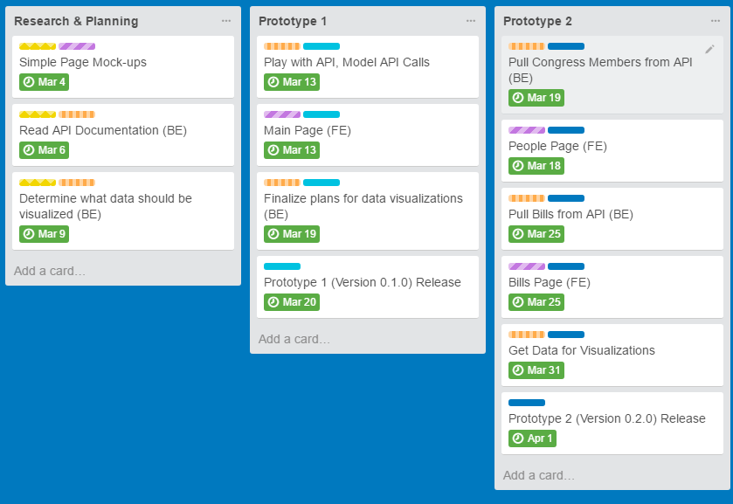
Project Management
Notes:
We ended up with six phases consisting of five iterations and a planning period in the beginning.
The Planning phase is where we drew up a few simple page mock-ups to give us an idea of what the application may end up looking like. This is also where we began looking into the specifics of our API and thinking about any data we wanted to visualize with the application.
Our first iteration was very simple. It was really just the main page. The main idea with this iteration was to get the Front-end team going while the Back-end team was playing with the API and finalizing plans for what data we wanted to get and how we were going to do that.
Iteration 2 is where the front-end team started making the information pages and the back-end team started to pull the information from the API that the front-end team needed to populate these pages.

Slide 13
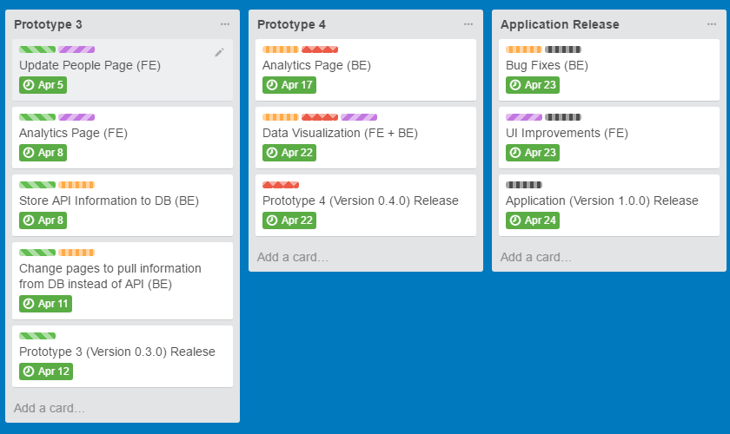
Project Management
Notes:
Iteration 3 saw an update to the people page, adding a cool UX feature that you will see in the demo as well as an analytics page. At this point all the information shown on the front-end is being pulled from the MongoDB database rather than directly from the API like in previous iterations.
In Iteration 4, we added functionality to the Analytics page and finalized data visualization.
And for the fifth and final iteration for this course, the back-end team fixed any bugs that we found and the front-end team finished up by making a few UI improvements.
So that was project development. As far as weekly team meetings, we had planned on moving from one meeting a week to two after the midterm presentation, but due to scheduling conflicts we found that it wasn’t going to happen reliably, so we mostly just stuck with one meeting a week.
Additionally, as you can see from the slide, we were working on development pretty much right up to the deadline. Meaning that, unfortunately, there wasn’t a lot of time for any additional features or reach goals. But, sometimes that is just how life goes.
So with that, I’ll pass it on to max to run you through a quick demo.

Slide 14
Demo
Hosted via DigitalOcean at http://159.203.84.202:3000/

Slide 15
Challenges/What We Learned
Asynchronous issues with Twitter API
Resolving issues with scope
Analyzing the large dataset
Learned how to communicate with third-party API, bringing results into database and choosing what to display
Learned to carefully read through documentation

Slide 16
Future Plans
Images of the members of Congress
More analytics (State/Region based, etc)
Information from previous years
Make more use out of location services

Slide 17
Questions?

